Slide 1
Prim’s Algorithm

Slide 2
Prim’s Algorithm-
Prim’s Algorithm is a famous greedy algorithm.
It is used for finding the Minimum Spanning Tree (MST) of a given graph.
To apply Prim’s algorithm, the given graph must be weighted, connected and undirected.

Slide 3
Prim’s Algorithm Implementation-
Step-01:
Randomly choose any vertex.
The vertex connecting to the edge having least weight is usually selected.

Slide 4
Step-02:
Find all the edges that connect the tree to new vertices.
Find the least weight edge among those edges and include it in the existing tree.
If including that edge creates a cycle, then reject that edge and look for the next least weight edge.

Slide 5
Step-03:
Keep repeating step-02 until all the vertices are included and Minimum Spanning Tree (MST) is obtained.

Slide 6
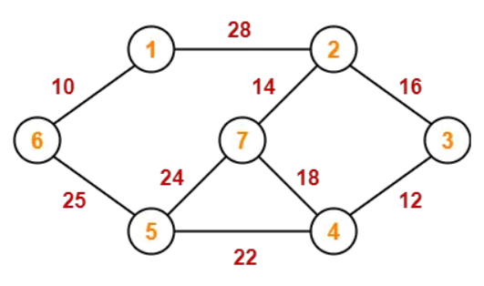
PRACTICE PROBLEMS BASED ON PRIM’S ALGORITHM-
Construct the minimum spanning tree (MST) for the given graph using Prim’s Algorithm-

Slide 7
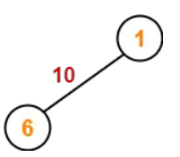
The above discussed steps are followed to find the minimum cost spanning tree using Prim’s Algorithm-
Step-01:

Slide 8
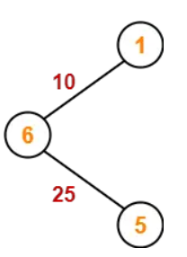
Step-02:

Slide 9
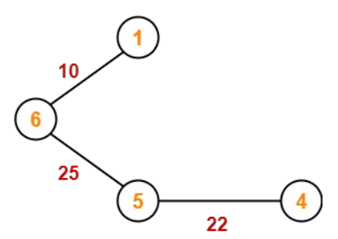
Step-03:

Slide 10
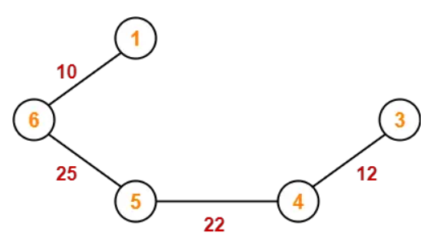
Step-04:

Slide 11
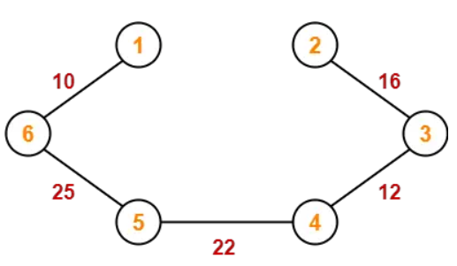
Step-05:

Slide 12
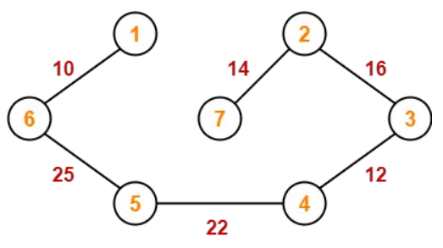
Step-06:

Slide 13
Since all the vertices have been included in the MST, so we stop.
Now, Cost of Minimum Spanning Tree
= Sum of all edge weights
= 10 + 25 + 22 + 12 + 16 + 14
= 99 units

